Slide 1

Binary Coded Hexadecimal to Seven-Segment Display EE648: VLSI Design Dr. Jason McNeely
May 1, 2017
Ryker Dial, Cody Gossel, and Zach Krehlik

Slide 2
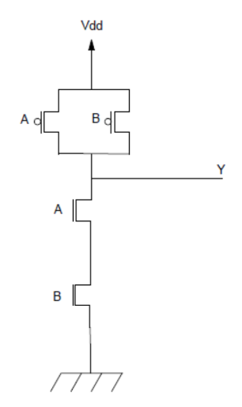
Overview
Introduction
What
Why
Design
Gate level logic
Transistor layout
Testing and Results

Slide 3
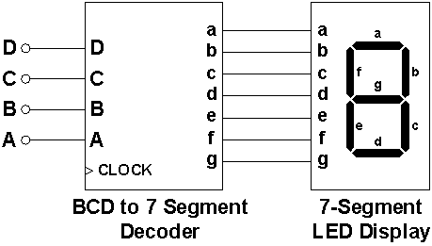
Introduction
Output a single hexadecimal digit equivalent of a 4-bit binary number
Logic schematics using NAND gates and inverters

Slide 4
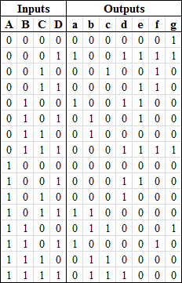
Design
Truth Table for each of the seven segments in the display
Determine logic equations for each segment

Slide 5
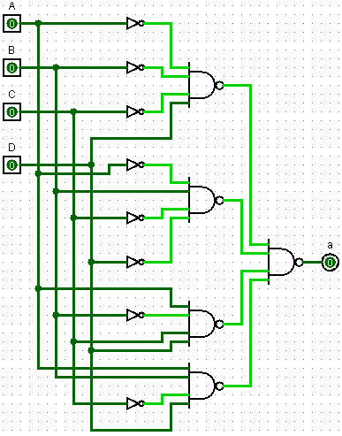

Design
Truth Table for each of the seven segments in the display
Determine logic equations for each segment
Convert logic to NAND equivalent
Create gates in Magic

Slide 6
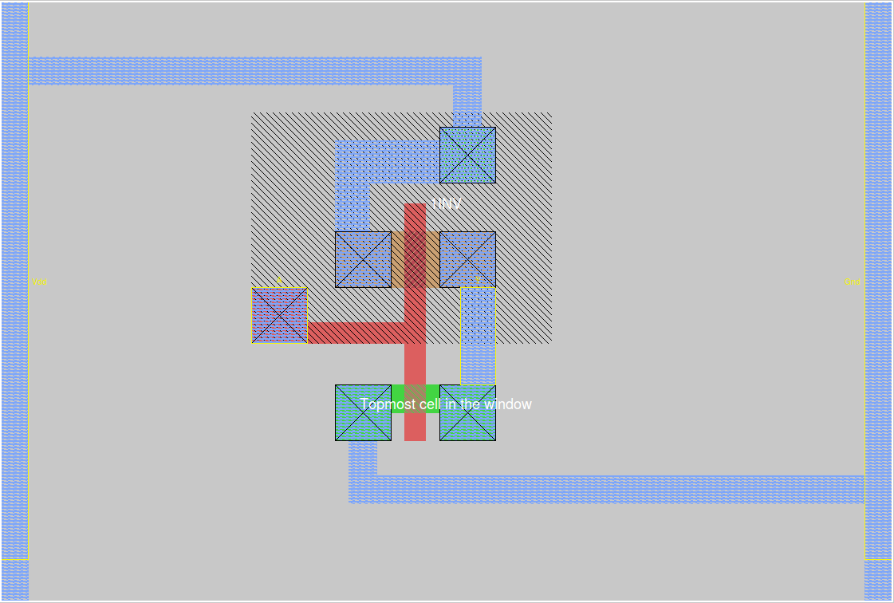
Design - Inverter Layout

Slide 7
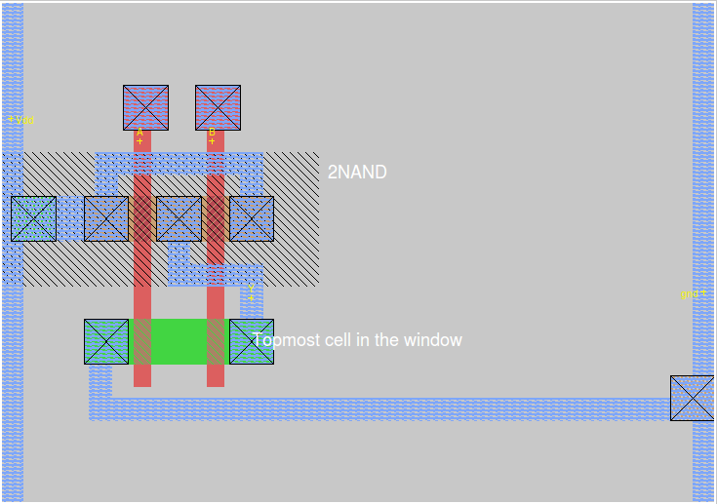
Design - NAND2 Layout

Slide 8
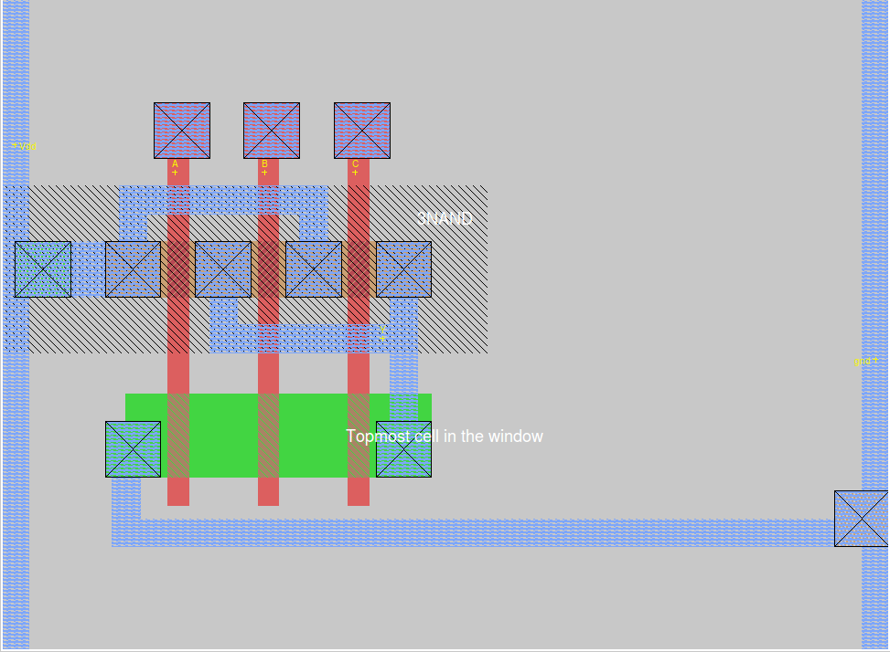
Design - NAND3 Layout

Slide 9
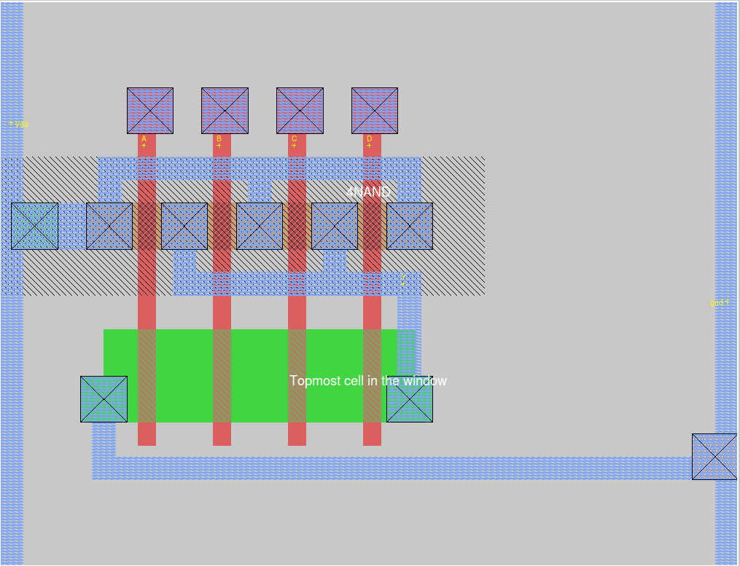
Design - NAND4 Layout

Slide 10
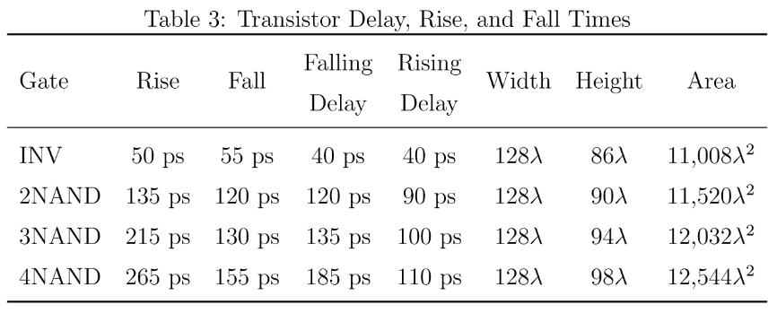
Testing

Slide 11
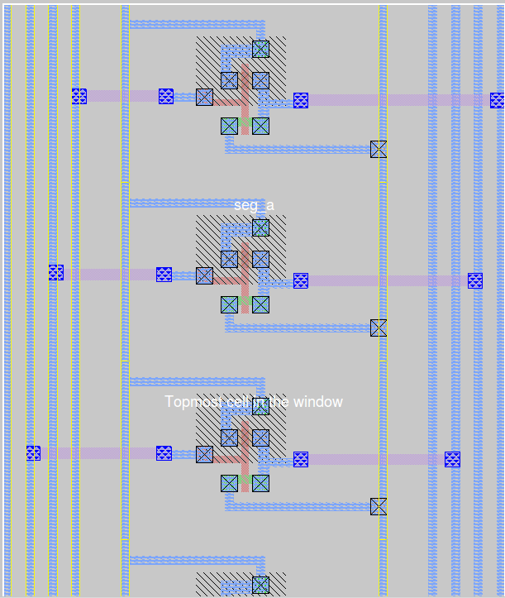
Design – Connecting Gates
After testing individual gates, connect to represent logic for output segments a - g

Slide 12
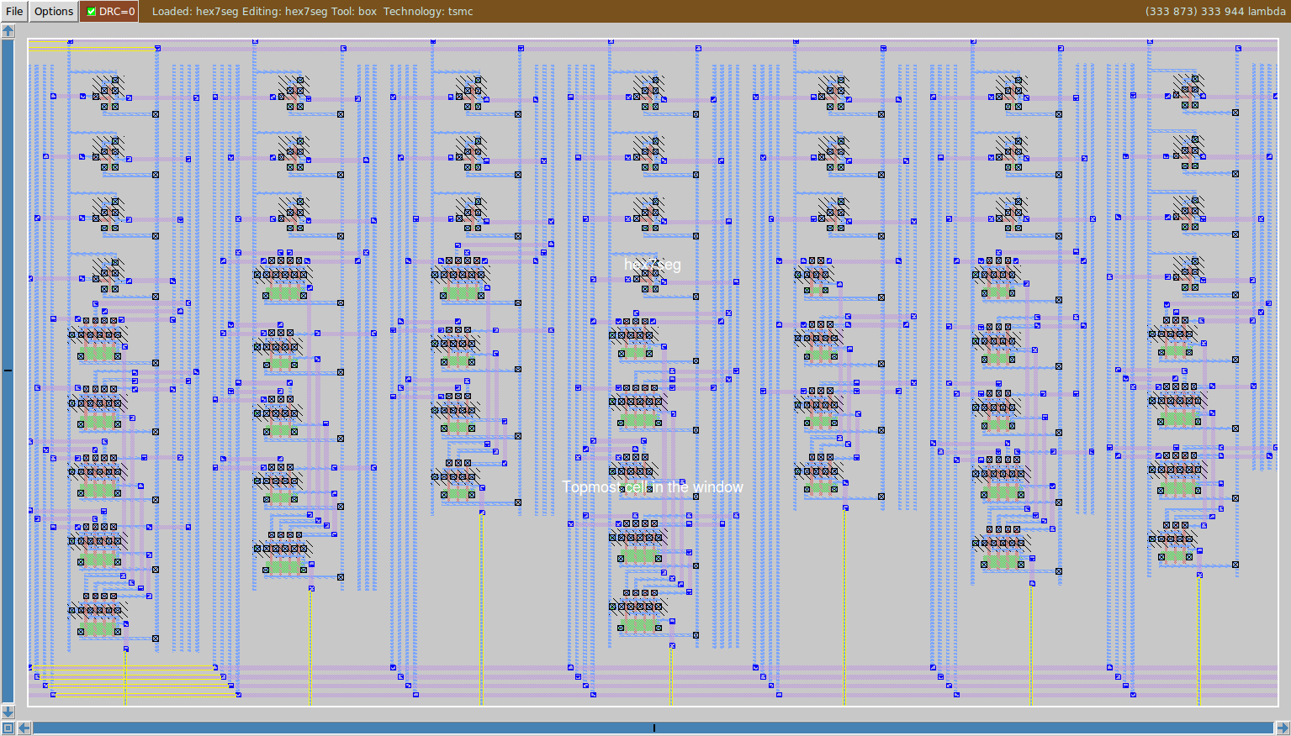
Complete Circuit Layout

Slide 13
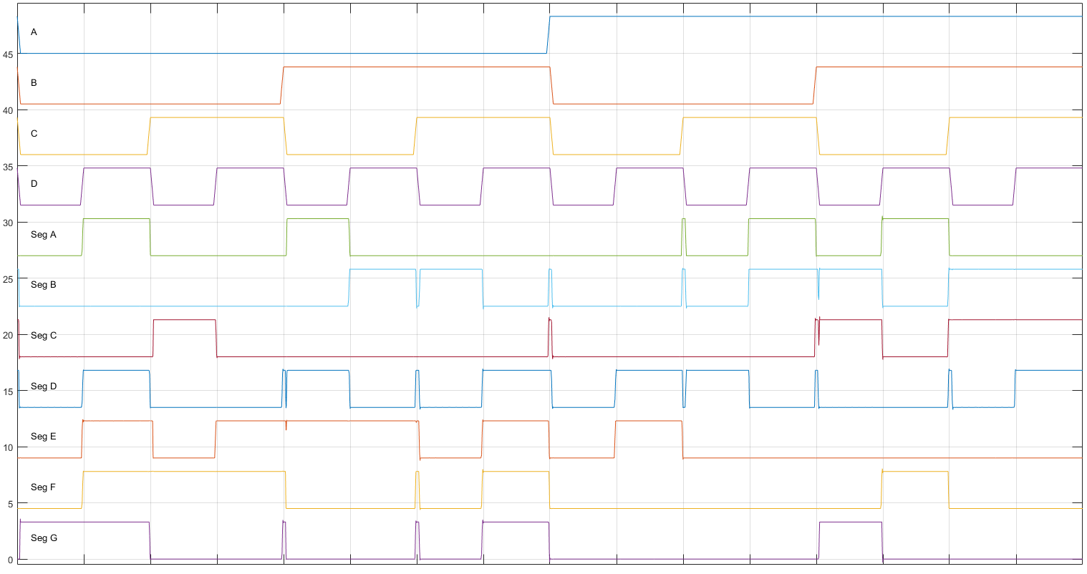
Final Test Results
A
B
C
D
sA
sB
sC
sD
sE
sF
sG

Slide 14

Acknowledgements
Special thanks to Dr. Jason McNeely for providing guidance, constructive criticism, inspiration and support throughout the design process

Slide 15


Slide 16
Title

Slide 17
Title

